Slide 1
The Drift Diusion Simulation of Coupled Ionic-Electronic Devices
By: Cem Bonfil

Slide 2
Overview
What is an ionic electronic device ?
Equations
Application of Finite Difference
Memristor
1-D and 2-D Memristor Simulations
2-D Simulation vs. Experimental Results
Conclusion

Slide 3
1-What is an ionic electronic device ?
Electrical behavior determined by the movement of mobile charged particles
Ions, holes and electrons
Natural: Ionic-channels in organic membranes
Engineered: Non-Volatile Memory, Organic FET, Memristor
Easy to fabricate, low operating voltage, slow

Slide 4



2- General Equations
Drift diffusion equation:
Continuity Equation:
Poisson’s Equation:

Slide 5
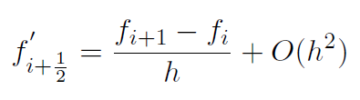


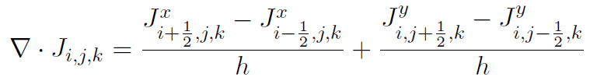

3. Application of Finite Difference
First Order Central Difference :
Second Order Central Difference:
Current Density
Continuity
Poisson’s Equation

Slide 6
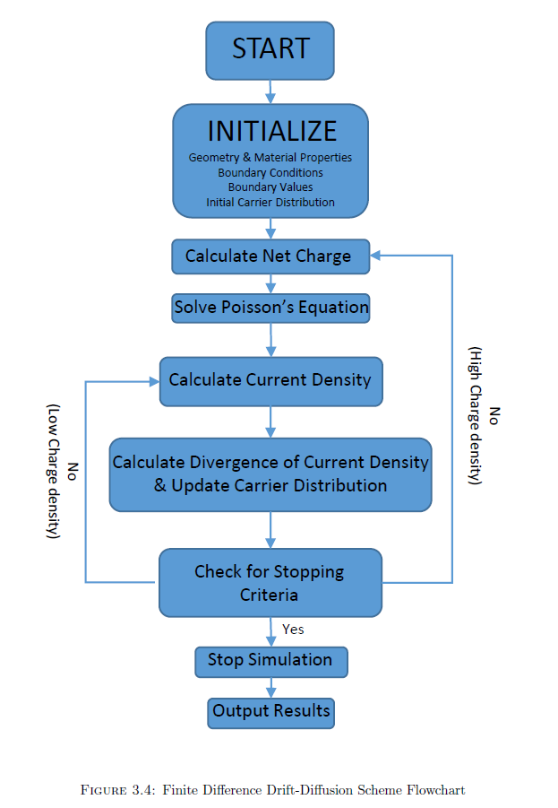
3.1- Solution Process

Slide 7
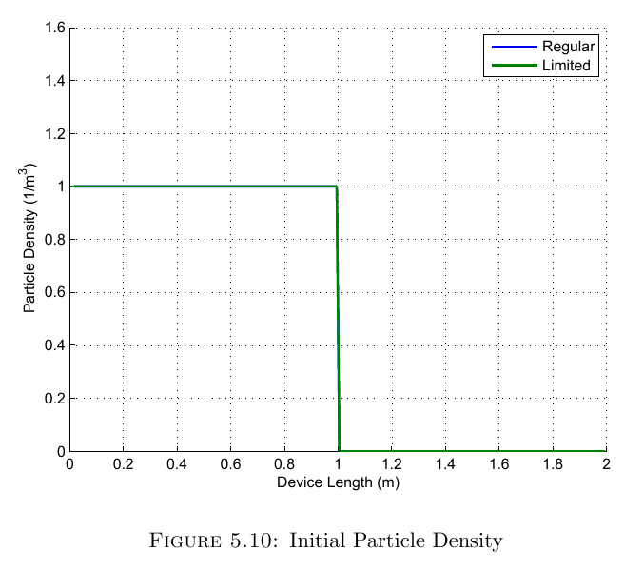
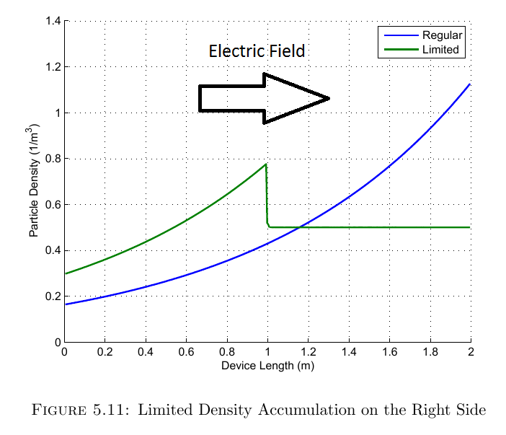
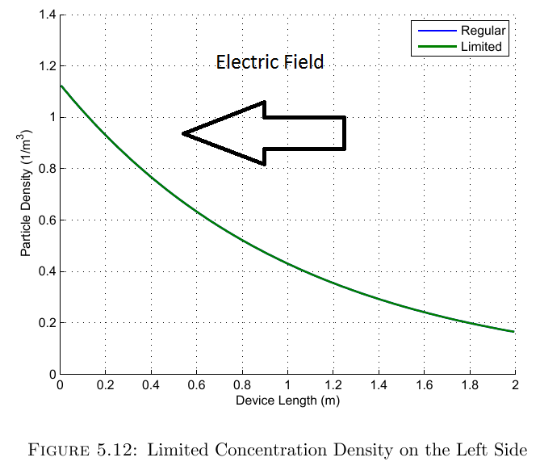
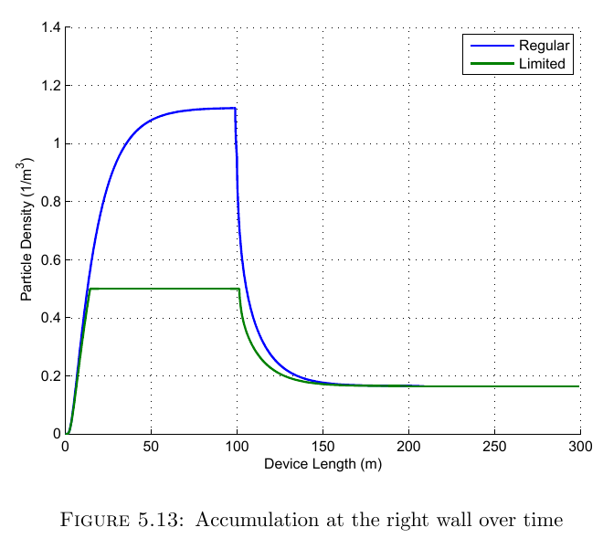
3.2- Current Limiting Mechanism
Pre calculate the next time step
Check for saturation
Set influx to zero (saturation)
Do nothing (no saturation)
Update carrier densities

Slide 8
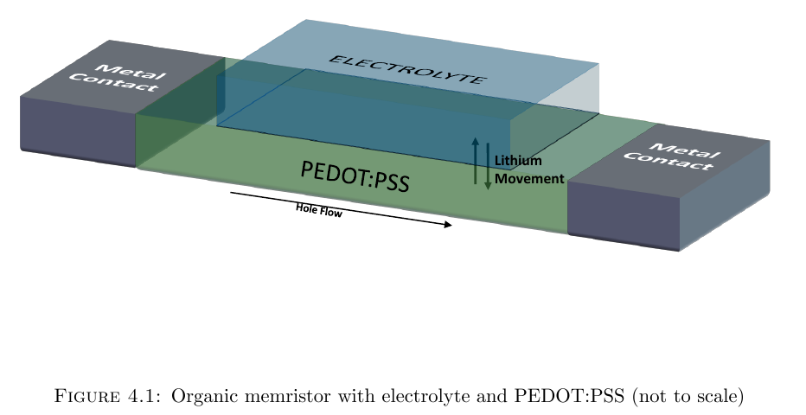
4- Memristor
Voltage controlled resistor with memory
Equation: M(q(t)) = V(t)/I(t)
2 Distinct types
Organic: Based on PEDOT:PSS….
Inorganic: Based on TiO2

Slide 9
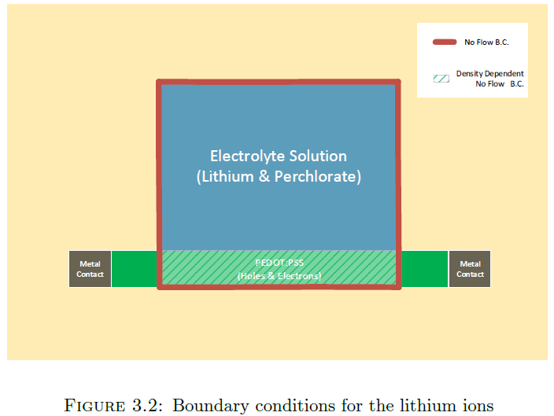
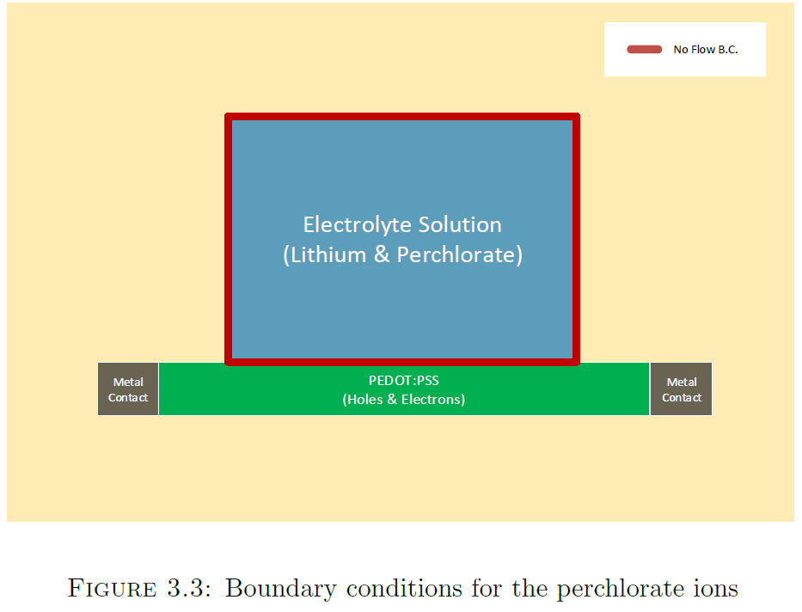
4.2- BoundarY conditions

Slide 10
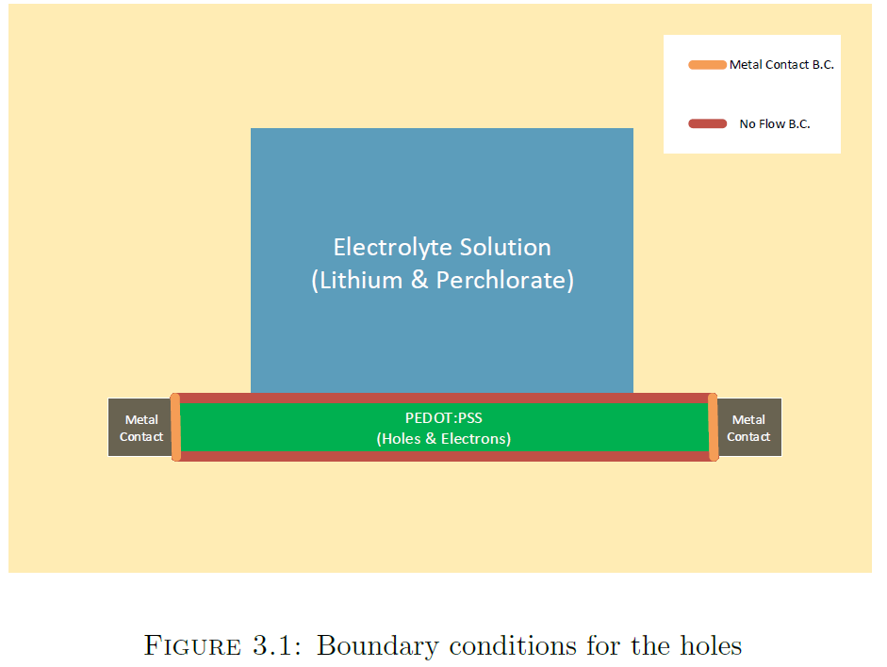
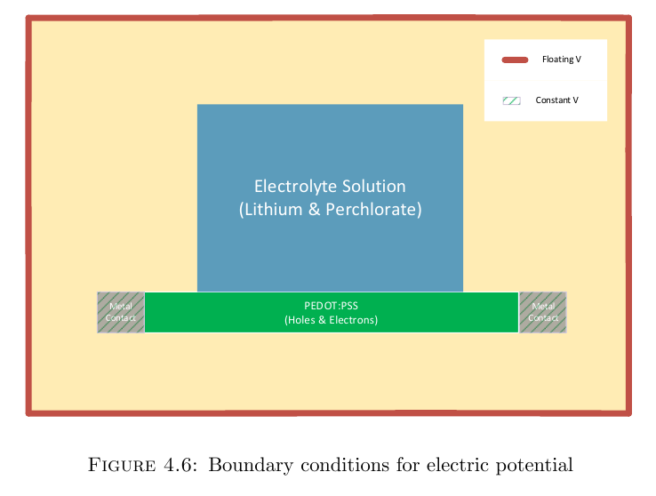
4.2- BoundarY conditions
Notes:
Add E,V Boundary conditions

Slide 11
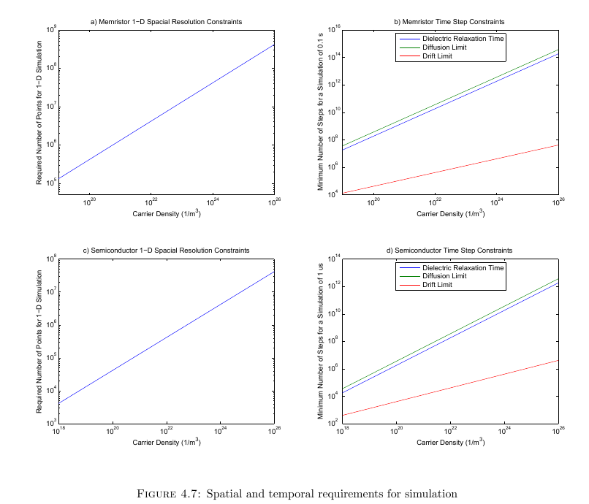
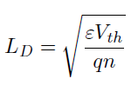



4.3- Numerical and Physical Limitations
Debye Length:
Dielectric Relaxation Time
CFL Conditions
Drift
Diffusion:

Slide 12

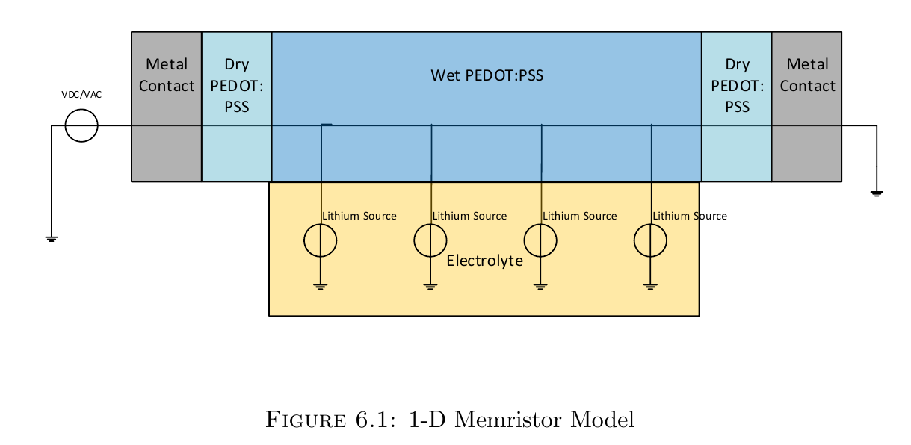


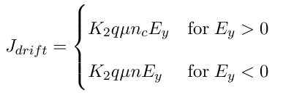
5- 1-D and 2-d memristor Simulations
Diffusion Current Density:
Electric Potential:
Electric Field:
Drift Current Density:

Slide 13
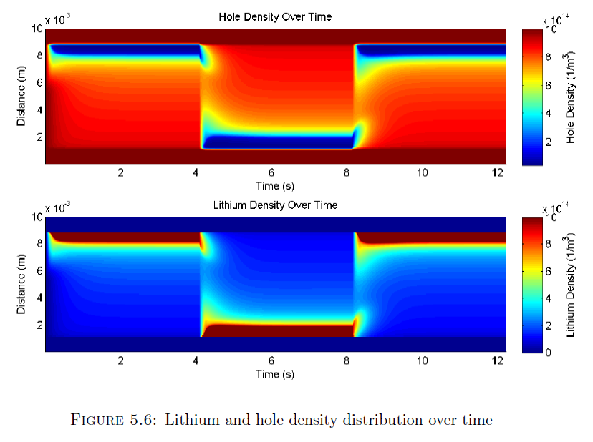
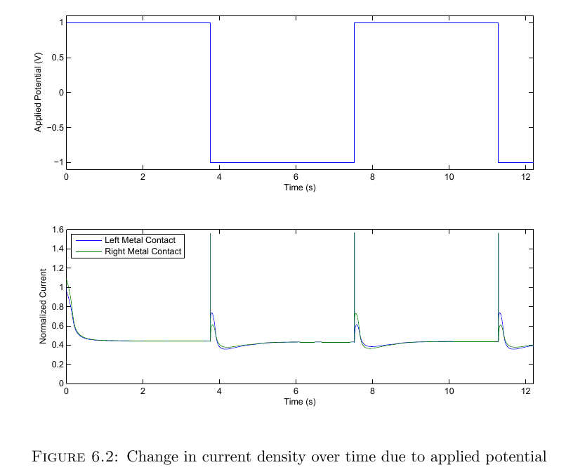
5.1 – 1-D Memristor Simulation
Notes:
Potential pulse train: Current Output, Lithium, hole density, Efield ?

Slide 14
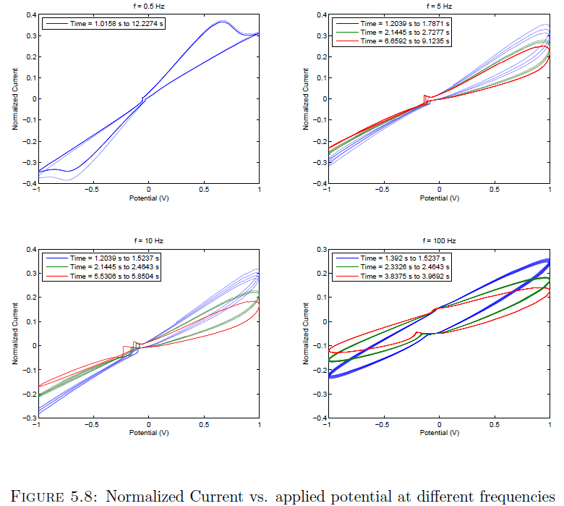
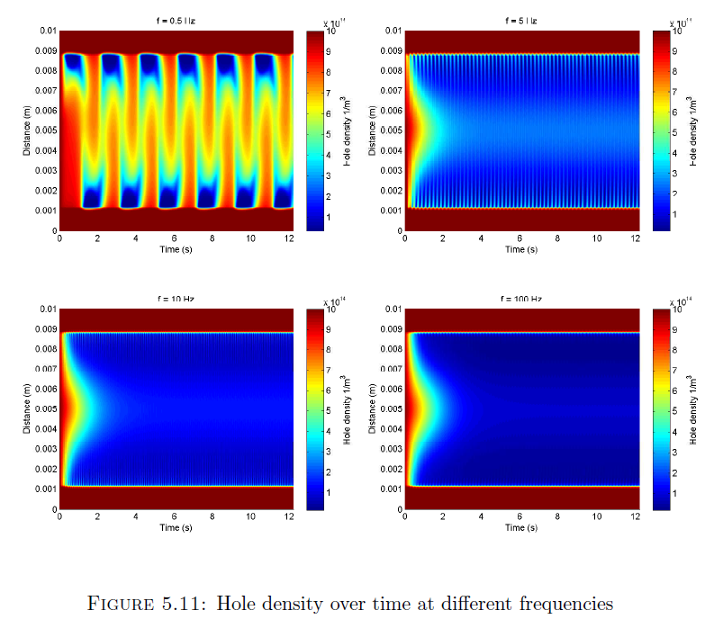
5.1 – 1-D Memristor Simulation cont.
Notes:
Sinusoid: Current Output, Lithium, perchlorate and hole density, Efield ?

Slide 15
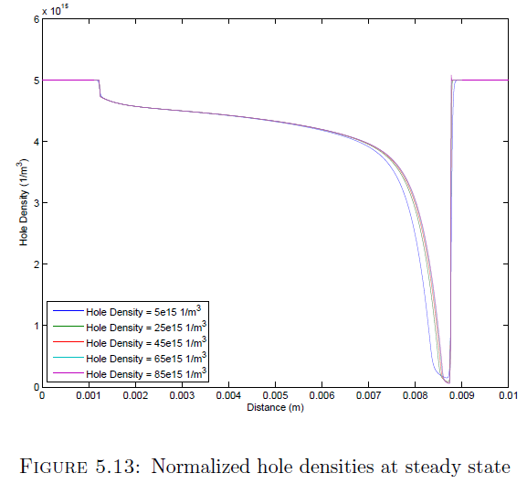
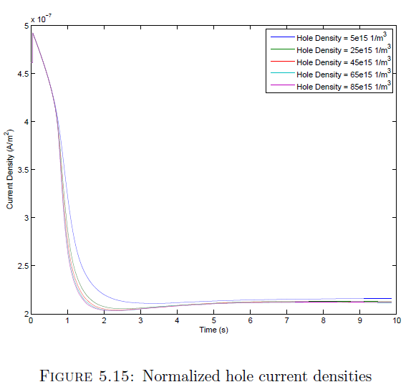
5.2- Scaling to Higher densities

Slide 16
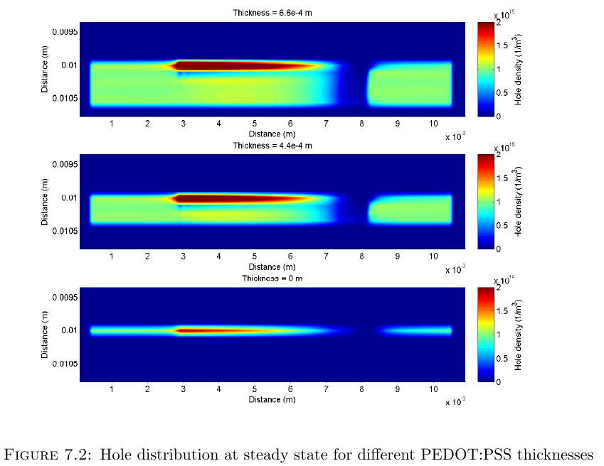
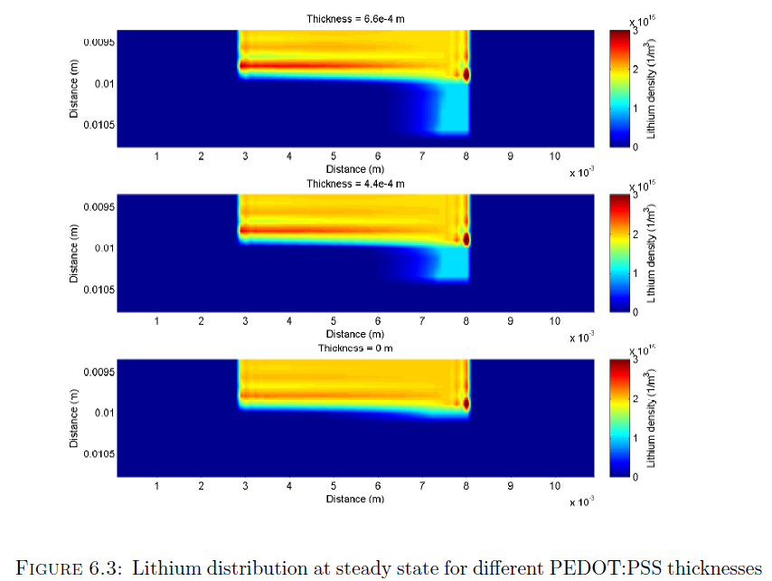
5.3- 2-D Memristor Simulations

Slide 17
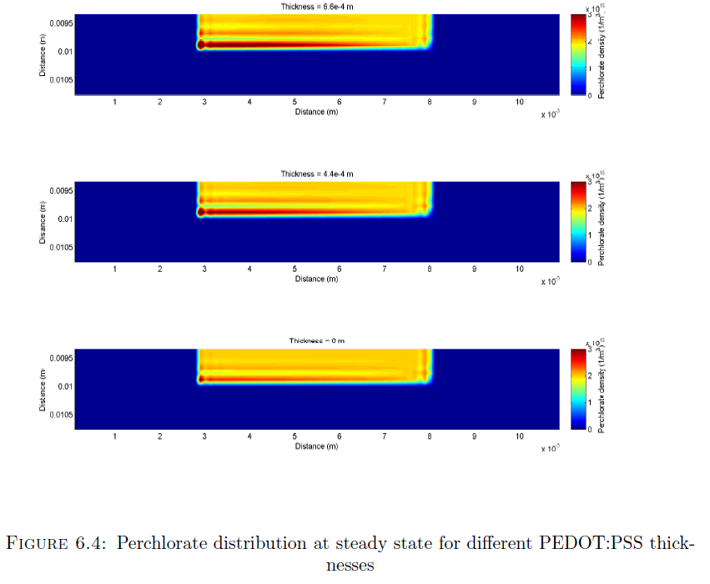
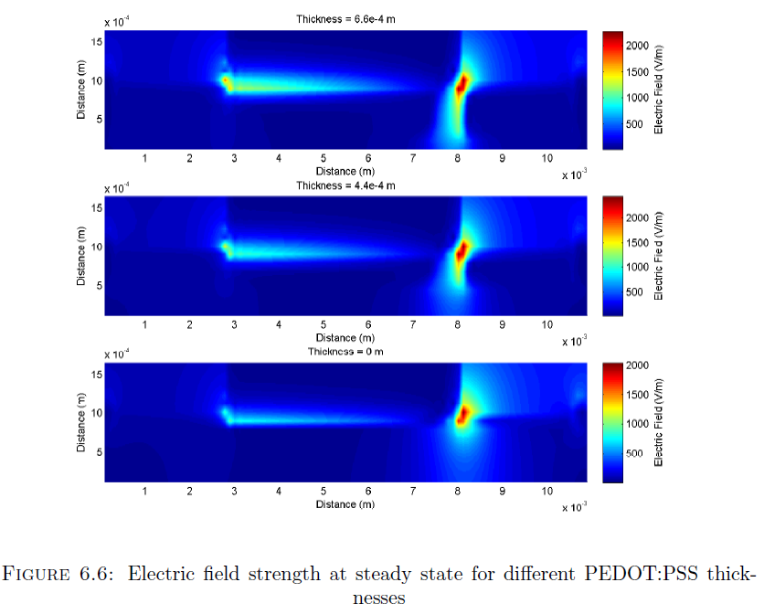
5.3- 2-D Memristor Simulations

Slide 18
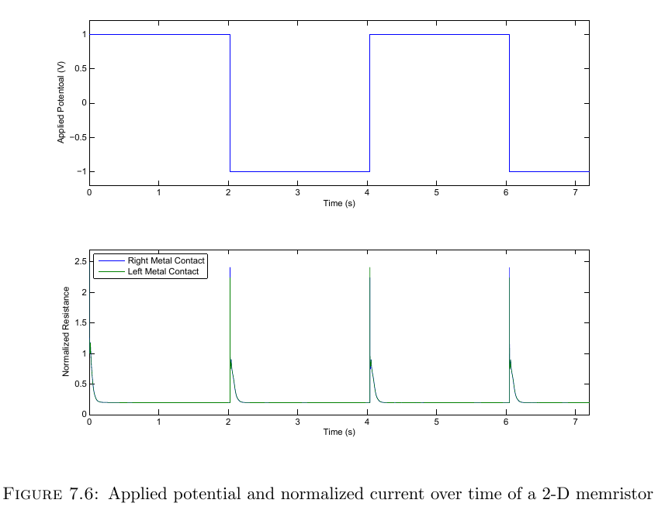
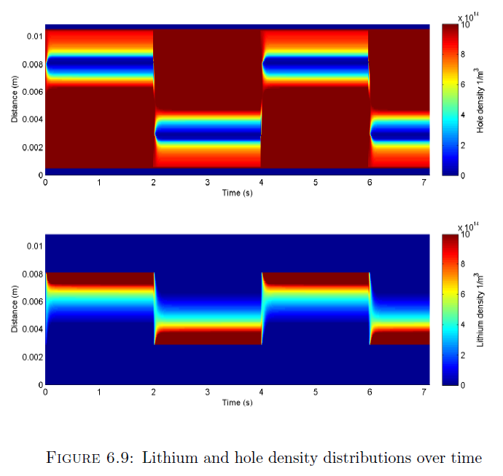
5.3- 2-D Memristor Simulations
Notes:
Potential pulse train: Current Output, Lithium, perchlorate and hole density, Efield ?

Slide 19
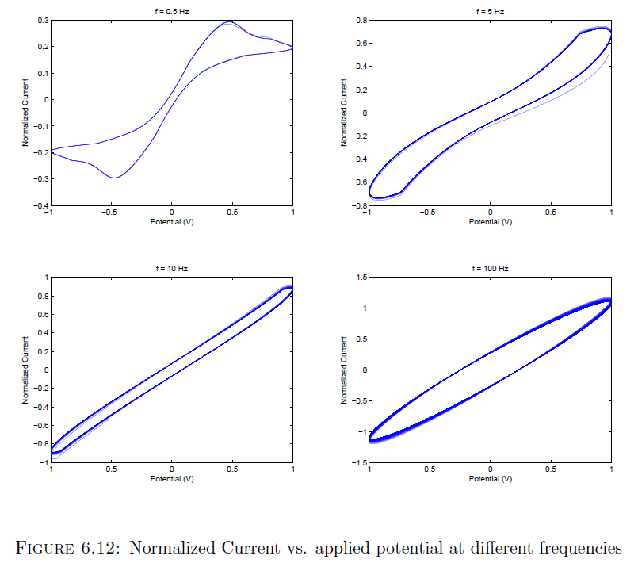
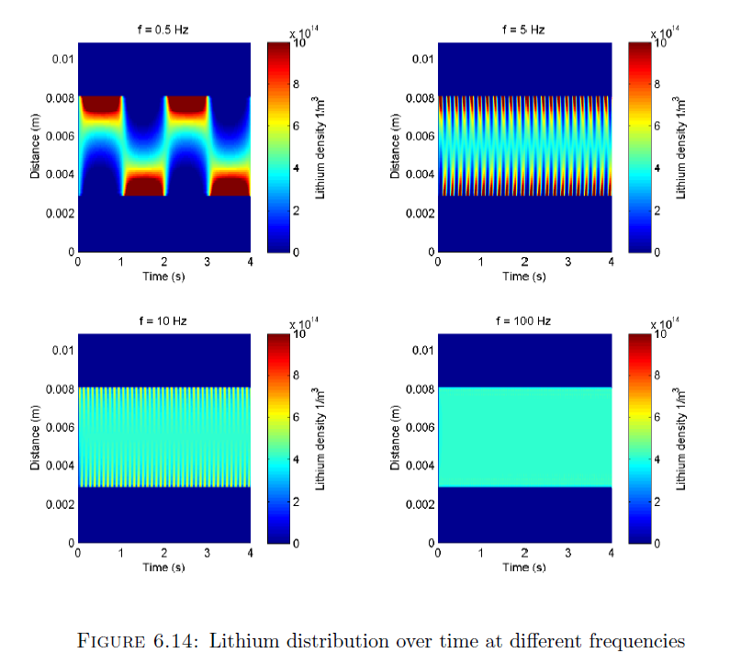
5.3- 2-D Memristor model cont.
Notes:
Sinusoid: Current Output, Lithium, perchlorate and hole density, Efield ?

Slide 20
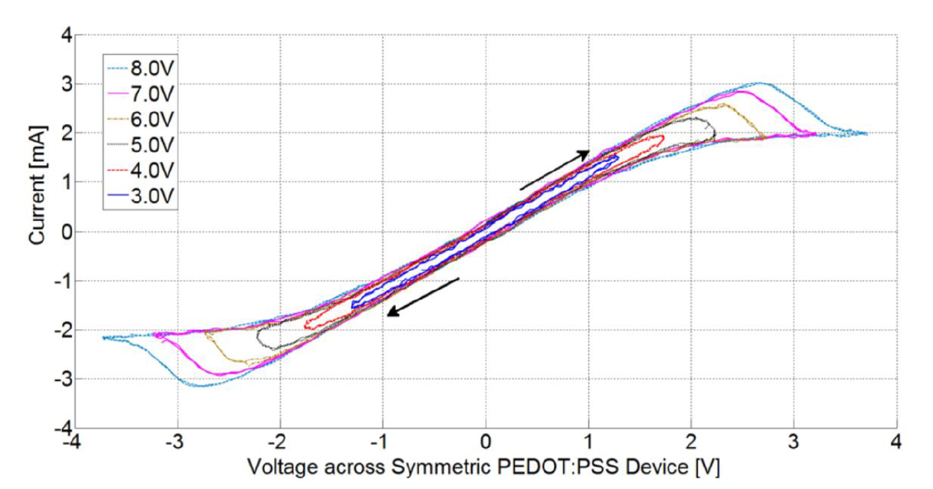
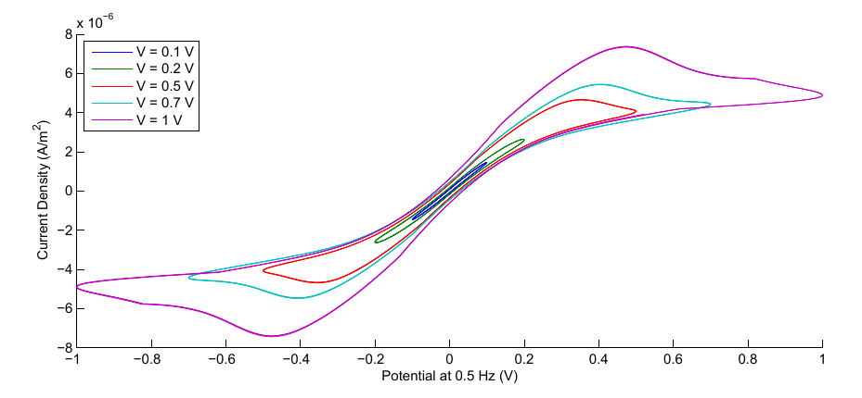
6. 2-D simulation vs. experimental results

Slide 21
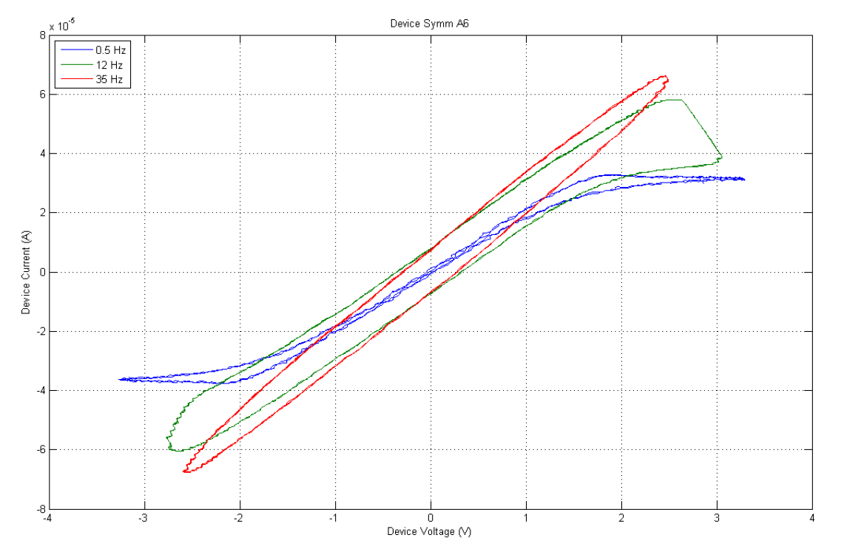
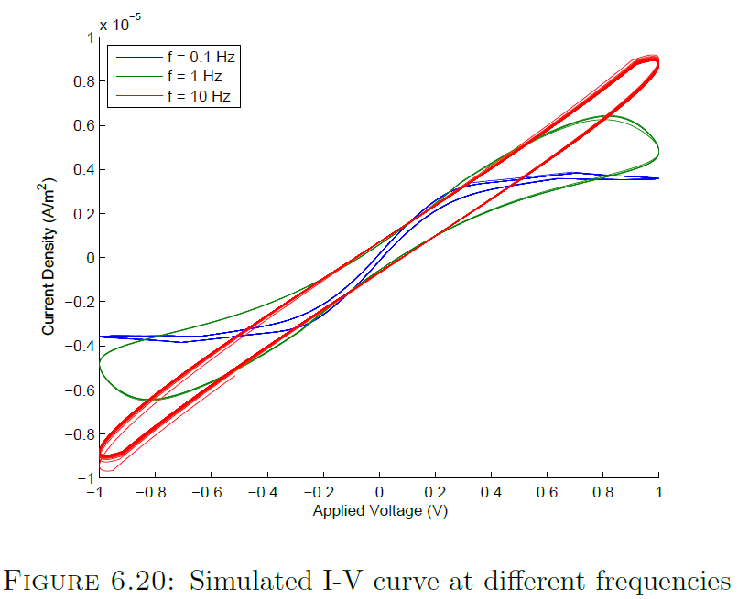
6. 2-D simulation vs. experimental results Cont.

Slide 22
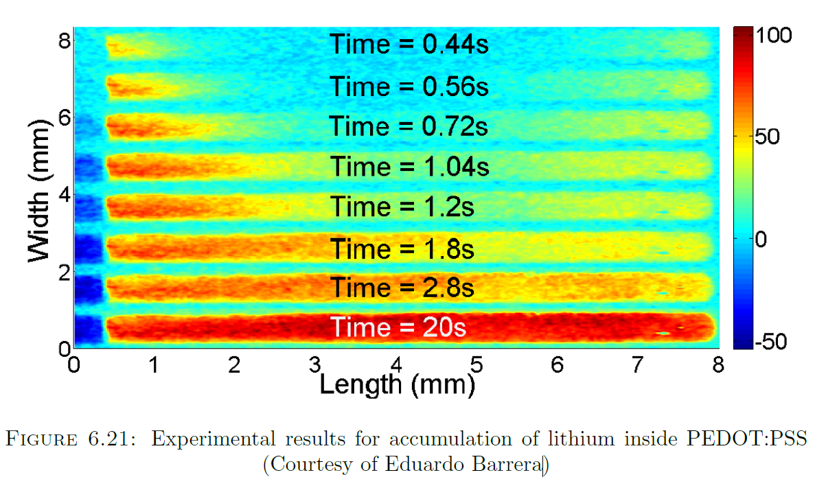
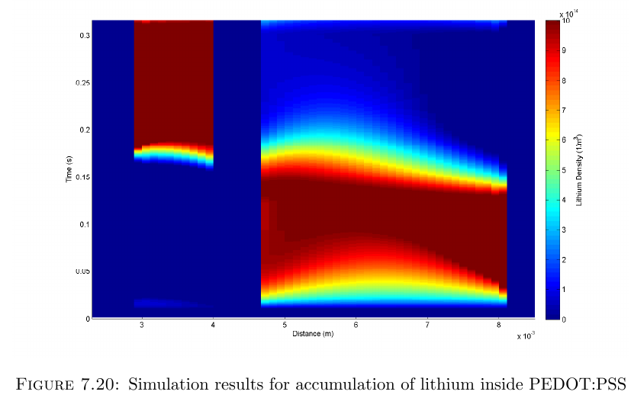
6. 2-D simulation vs. experimental results Cont.

Slide 23
7- Conclusion
Simulation of an organic memristor (Can be extended to other ionic devices)
Density Limiting Mechanism
Density scaling issues, parameter fitting
Additional modeling of hole transport mechanisms
Different Geometries
Further experimental verification
3D Modelling

Slide 24
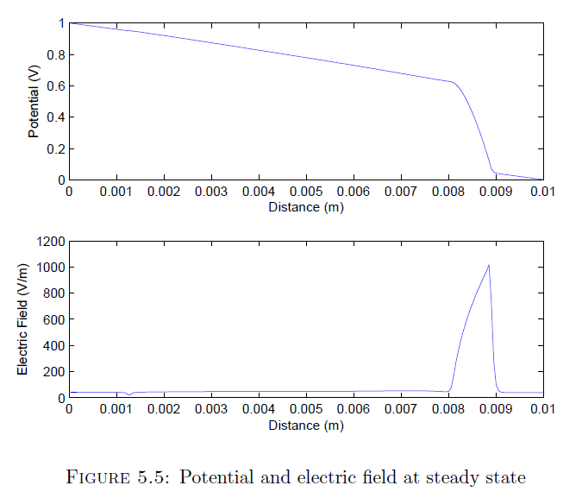
Electric Field

Slide 25
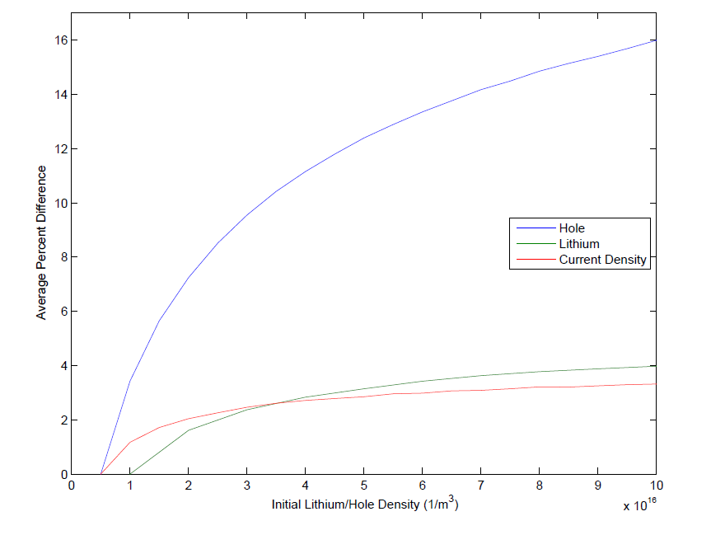
Percentage Difference

